Slide 1
IustitiaUz
When Justice is the highest priority
Januzakov Sh
Bobokulov A
Sadulloyev Sh

Slide 2
Who are we?
Imagine a person who broke traffic rules by running a red light. Due to road radar technology, this person has been identified and issued a fine.
However, it may not be clear how this person will be notified about the fine or the amount they need to pay.
Here our solution comes in.

Slide 3
Why us?
1
2
3
4
Inconvenience
Unreliability
Inaccessibility
No guidance
The problem is that not everybody may know where to address regarding their issue, or where to find the solution. Long queues.
Organizational problem solving
The problem is that even if everybody knew which governmental agency to visit regarding their issue, they may not have location independence.
There are various opinions regarding where to go and to whom to address, but no one can tell for sure what to do in a specific situation.
Unreliable, misguided news, extortion
Nowadays, nobody tells people what to do in real-life situations. Especially, when people come across legal issues.
Search for information from many sites, enroll in the reception of lawyer lawyers

Slide 4
IustitiaUz is
1
2
3
4
Convenience
Reliance
Guidence
Accessibility
No need to search for tons of web pages and other sources.
No need to call lawyers. Only personalized responses.
You can access the service from anypoint of the globe and receive instant responses through the website.
We have integrated the most credible sources into our platform, namely my.gov.uz, and lex.uz.
Step-by-step guide for contacting appropriate government agencies.

Slide 5
Target Audience
Society
Government
Every Uzbekistan citizen shall know their rights and obligations.
Comparison with different countries
No fraud
And high literacy rate in terms of law

Slide 6
Structure
Search traffic volume | Databases namely huquqiyportal.uz, my.gov.uz, lex.uz websites to get information and 19 codes.
Relevance of advertising
Advanced search functions | There are two types of search, parsing algorithm and keyword search.
Regional search support | Analyzing the laws and rights of foreign countries
User Interface | The purpose of the site is indicated, there is an opportunity to send a request that is convenient for the user. Eye-pleasant, modern and understandable design.
Mobile optimization | A website that works for phones as well
Integration with other services | Integration with Artificial Intelligence.

Slide 7
Monetization
Status | Opportunities
Basic | 3 problems a day | Output relevant article. No suggestions | No guidance | $0
Golden | 10 problems a day | Relevant article + detailed information | Relevant Sources/websites | $9.99
Brilliant | 20 problems a day | Relevant article + detailed information | Step-by-Step Guidance | $14.99
VIP
For government use only

Slide 8



Distinction from others
AI Integration
Credible Databases Inclusion
Step-by-Step Guidance
Lex.uz, Constitution and Codes,
Detailed explanation of solutions based on user’s input

Slide 9
Team
Asilbek Bobokulov
Graduate of Al-Khwarizmi Specialized School
Freshman at New Uzbekistan University
C++, Frontend Developer
Project Manager
Initialized Idea and project
Shohjaxon Jonuzoqov
Graduate of Presidential School in Bukhara
Freshman at New Uzbekistan University
Python, Full-Stack Developer
Built the website
Integrated AI into website
Shavkat Sadulloyev
Graduate of Presidential School in Bukhara
Freshman at New Uzbekistan University
C++, Python Dev.
Open Data (Databases, AI APIs) Collector
Content (Presentation) Creator

Slide 10
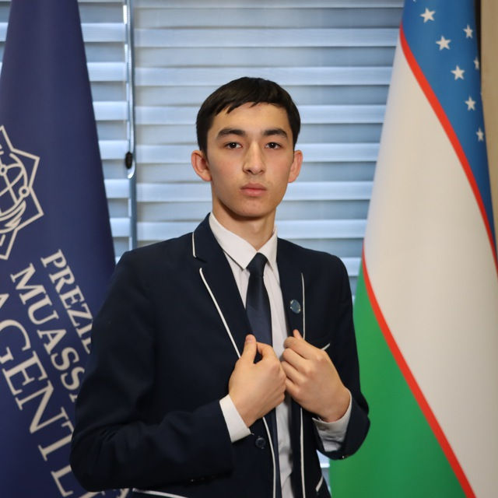
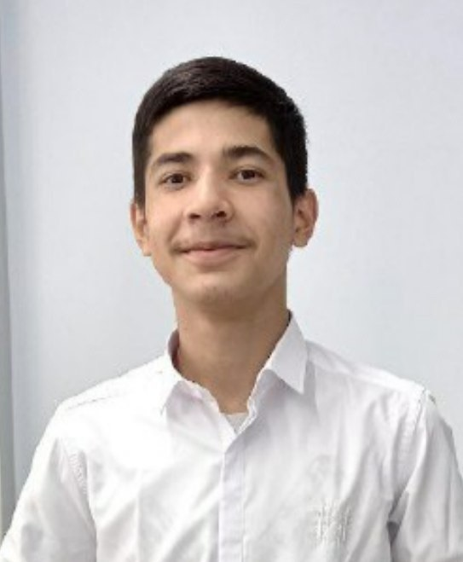
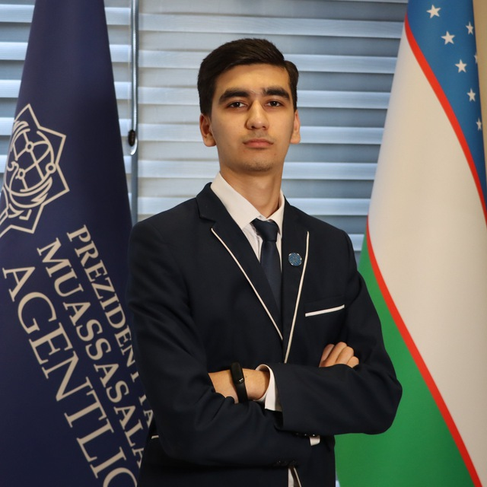



Constant us
Shavkat Sadulloyev
Asilbek Bobokulov
Shohjaxon Januzakov

